Slide 1
ANEMIA

Slide 2
AVANCE A JUNIO 2020
META 2021
Niños de 6 a 35m
Niños de 6 a 11m
 | Metas
 | 2019 | 2020 | 2021
AREQUIPA - ENDES | 33.4 | 29.7 | 23.6
PERU - ENDES | 39.3 | 32.4 | 27.5
 | Metas
 | 2019 | 2020 | 2021
AREQUIPA - ENDES | 50.8 | 41.0 | 33.6
PERU - ENDES | 54.4 | 45.9 | 40.2
MICROREDES | Evaluados | Anemia | % | Resultados
M.R. LA PAMPA | 148 | 22 | 14.9% | Bueno
M.R. OCOÑA | 37 | 11 | 29.7% | Bueno
M.R. SAN GREGORIO | 108 | 22 | 20.4% | Bueno
M.R. SAN JOSE | 152 | 12 | 7.9% | Bueno
M.R.IQUIPI | 110 | 16 | 14.5% | Bueno
M.R. ACARI | 49 | 16 | 32.7% | Malo
M.R. CARAVELI | 166 | 52 | 31.3% | Bueno
M.R. CHALA | 252 | 41 | 16.3% | Bueno
HOSPITAL CAMANA | 46 | 4 | 8.7% | Bueno
RED SALUD | 1068 | 196 | 18.4% | Bueno
MICROREDES | Evaluados | Anemia | % | Resultados
M.R. LA PAMPA | 41 | 8 | 19.5% | Bueno
M.R. OCOÑA | 9 | 3 | 33.3% | Bueno
M.R. SAN GREGORIO | 25 | 10 | 40% | Bueno
M.R. SAN JOSE | 47 | 5 | 10.6% | Bueno
M.R.IQUIPI | 38 | 8 | 21.0% | Bueno
M.R. ACARI | 10 | 2 | 20.0% | Bueno
M.R. CARAVELI | 48 | 19 | 39.5% | Bueno
M.R. CHALA | 57 | 12 | 21.0% | Bueno
HOSPITAL CAMANA | 16 | 2 | 12.5% | Bueno
RED SALUD | 291 | 69 | 23.7% | Bueno
FUENTE: Sistema de Información del Estado Nutricional – SIEN 2020.

Slide 3
Anemia en Niños de 6 a 35 meses
I SEMESTRE 2020
2019
2020
Evaluados | Anemia | % | Evaluados | Anemia | %
1139 | 254 | 22.3 | 1068 | 196 | 18.4
3.9%
Muy Alta Prevalencia ≥ 40%
Alta Prevalencia entre 20 - 39.9%
Mediana Prevalencia entre 5 - 19.9 %
Baja Prevalencia ≤ 4.9%
Puntos de Corte para Impacto de Salud Pública – OMS
Anemia
FUENTE: Sistema de Información del Estado Nutricional – SIEN 2019- 2020.

Slide 4
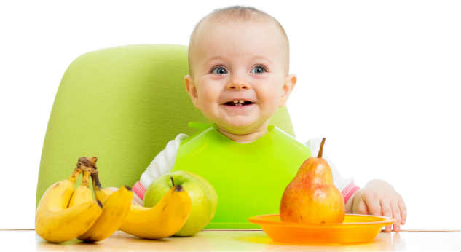
Anemia en Niños de 6 y 11 meses
I SEMESTRE 2020
2019
2020
Evaluados | Anemia | % | Evaluados | Anemia | %
179 | 41 | 22.9% | 291 | 69 | 23.7%
Muy Alta Prevalencia ≥ 40%
Alta Prevalencia entre 20 - 39.9%
Mediana Prevalencia entre 5 - 19.9 %
Baja Prevalencia ≤ 4.9%
FUENTE: Sistema de Información del Estado Nutricional – SIEN 2019- 2020.

Slide 5
Anemia en Niños de 6 a 35 meses I SEMESTRE 2020
CAMANA
 | ANEMIA
 | Nro de | ANEMIA LEVE |  | ANEMIA MODERADA |  | ANEMIA SEVERA |  | TOTAL ANEMIAS
ESTABLECIMIENTO | Evaluado | Nº | % | Nº | % | Nº | % | Nº | %
M.R. LA PAMPA | 148 | 19 | 12.8% | 3 | 2.0% | 0 | 0.0% | 22 | 14.9%
M.R. OCOÑA | 37 | 9 | 24.3% | 2 | 5.4% | 0 | 0.0% | 11 | 29.7%
M.R. SAN GREGORIO | 108 | 18 | 16.7% | 4 | 3.7% | 0 | 0.0% | 22 | 20.4%
M.R. SAN JOSE | 152 | 10 | 6.6% | 2 | 1.3% | 0 | 0.0% | 12 | 7.9%
P.S SECOCHA | 25 | 6 | 24.0% | 2 | 8.0% | 0 | 0.0% | 8 | 32.0%
P.S URASQUI | 21 | 5 | 23.8% | 2 | 9.5% | 0 | 0.0% | 7 | 33.3%
HOSPITAL CAMANA | 46 | 4 | 8.7% | 0 | 0.0% | 0 | 0.0% | 4 | 8.7%
FUENTE: Sistema de Información del Estado Nutricional – SIEN 2020.

Slide 6
Anemia en Niños de 6 a 35 meses I SEMESTRE 2020
CARAVELI
 | ANEMIA
 | Nro de | ANEMIA LEVE |  | ANEMIA MODERADA |  | ANEMIA SEVERA |  | TOTAL ANEMIAS
ESTABLECIMIENTO | Evaluado | Nº | % | Nº | % | Nº | % | Nº | %
M.R. ACARI | 49 | 6 | 12.2% | 10 | 20.4% | 0 | 0.0% | 16 | 32.7%
M.R. CARAVELI | 166 | 38 | 22.9% | 14 | 8.4% | 0 | 0.0% | 52 | 31.3%
M.R. CHALA | 252 | 31 | 12.3% | 10 | 4.0% | 0 | 0.0% | 41 | 16.3%
FUENTE: Sistema de Información del Estado Nutricional – SIEN 2020.

Slide 7
Anemia en Niños de 6 a 35 meses I SEMESTRE 2020
CONDESUYOS
 | ANEMIA
 | Nro de | ANEMIA LEVE |  | ANEMIA MODERADA |  | ANEMIA SEVERA |  | TOTAL ANEMIAS
ESTABLECIMIENTO | Evaluado | Nº | % | Nº | % | Nº | % | Nº | %
IQUIPI | 55 | 0 | 0.0% | 1 | 1.8% | 0 | 0.0% | 1 | 1.8%
PIUCA | 9 | 0 | 0.0% | 0 | 0.0% | 0 | 0.0% | 0 | 0.0%
FUENTE: Sistema de Información del Estado Nutricional – SIEN 2020.

Slide 8
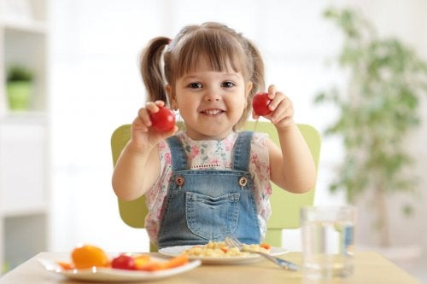
 | ANEMIA
 | Nro de | ANEMIA LEVE |  | ANEMIA MODERADA |  | ANEMIA SEVERA |  | TOTAL ANEMIAS
ESTABLECIMIENTO DE SALUD | Evaluado | Nº | % | Nº | % | Nº | % | Nº | %
Hospital Camaná | 46 | 4 | 8.7% | 0 | 0.0% | 0 | 0.0% | 4 | 8.7%
M.R. LA PAMPA | 148 | 19 | 7.2% | 3 | 0.8% | 0 | 0 | 22 | 8.0%
C.S. LA PAMPA | 42 | 8 | 19.0% | 0 | 0.0% | 0 | 0.0% | 8 | 19.0%
P.S. El Carmen | 59 | 9 | 15.3% | 3 | 5.1% | 0 | 0.0% | 12 | 20.3%
P.S. La Punta | 3 | 0 | 0.0% | 0 | 0.0% | 0 | 0.0% | 0 | 0.0%
P.S. J.P.V. G. | 16 | 0 | 0.0% | 0 | 0.0% | 0 | 0.0% | 0 | 0.0%
P.S. Solidaridad | 23 | 2 | 8.7% | 0 | 0.0% | 0 | 0.0% | 2 | 8.7%
P.S. Quilca | 5 | 0 | 0.0% | 0 | 0.0% | 0 | 0.0% | 0 | 0.0%
M.R. OCOÑA | 37 | 9 | 20.8% | 2 | 2.8% | 0 | 0.0% | 11 | 23.6%
C.S. OCOÑA | 15 | 5 | 33.3% | 0 | 0.0% | 0 | 0.0% | 5 | 33.3%
P.S. La Planchada | 1 | 0 | 0.0% | 0 | 0.0% | 0 | 0.0% | 0 | 0.0%
P.S. Pescadores | 3 | 1 | 33.3% | 0 | 0.0% | 0 | 0.0% | 1 | 33.3%
P.S. La Eugenia | 18 | 3 | 16.7% | 2 | 11.1% | 0 | 0.0% | 5 | 27.8%
M.R. SAN GREGORIO | 108 | 18 | 10.7% | 4 | 2.5% | 0.0% | 0 | 22 | 13.2%
C.S. SAN GREGORIO | 78 | 14 | 17.9% | 3 | 3.8% | 0 | 0.0% | 17 | 21.8%
P.S. Hda. El Medio | 28 | 4 | 14.3% | 1 | 3.6% | 0 | 0.0% | 5 | 17.9%
P.S. Sonay | 2 | 0 | 0.0% | 0 | 0.0% | 0 | 0.0% | 0 | 0.0%
M.R. SAN JOSE | 152 | 10 | 7.6% | 2 | 0.3% | 0 | 0 | 12 | 8.5%
C.S SAN JOSE | 8 | 1 | 12.5% | 0 | 0.0% | 0 | 0.0% | 1 | 12.5%
P.S. Pucchun | 73 | 2 | 2.7% | 1 | 1.4% | 0 | 0.0% | 3 | 4.1%
P.S. El Cardo | 13 | 0 | 0.0% | 0 | 0.0% | 0 | 0.0% | 0 | 0.0%
P.S. El Puente | 27 | 0 | 0.0% | 0 | 0.0% | 0 | 0.0% | 0 | 0.0%
P.S. F. Cartagena Huacapuy | 31 | 7 | 22.6% | 1 | 0.0% | 0 | 0.0% | 8 | 25.8%
M.R. IQUIPI | 110 | 11 | 12.0% | 5 | 4.8% | 0 | 0 | 16 | 16.8%
C.S. IQUIPI | 55 | 0 | 0.0% | 1 | 1.8% | 0 | 0.0% | 1 | 1.8%
P.S. Piuca | 9 | 0 | 0.0% | 0 | 0.0% | 0 | 0.0% | 0 | 0.0%
P.S. Urasqui | 25 | 6 | 24.0% | 2 | 8.0% | 0 | 0.0% | 8 | 32.0%
P.S. Secocha | 21 | 5 | 23.8% | 2 | 9.5% | 0 | 0.0% | 7 | 33.3%
Anemia en Niños < 3 Años I SEMESTRE 2020
FUENTE: Sistema de Información del Estado Nutricional – SIEN 2020.

Slide 9
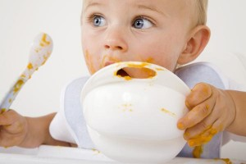
 | ANEMIA
 | Nro de | ANEMIA LEVE |  | ANEMIA MODERADA |  | ANEMIA SEVERA |  | TOTAL ANEMIAS
ESTABLECIMIENTO DE SALUD | Evaluado | Nº | % | Nº | % | Nº | % | Nº | %
M.R. ACARI | 49 | 6 | 7.4% | 10 | 11.6% | 0 | 0 | 16 | 19.0%
C.S. ACARI | 0 | 0 | 0.0% | 0 | 0.0% | 0 | 0.0% | 0 | 0.0%
P.S. Bella Unión | 4 | 0 | 0.0% | 0 | 0.0% | 0 | 0.0% | 0 | 0.0%
P.S. Jaqui | 15 | 1 | 6.7% | 2 | 13.3% | 0 | 0.0% | 3 | 20.0%
P.S.Lomas | 12 | 1 | 8.3% | 0 | 0.0% | 0 | 0.0% | 1 | 8.3%
P.S. Yauca | 18 | 4 | 22.2% | 8 | 44.4% | 0 | 0.0% | 12 | 66.7%
M.R. CARAVELI | 166 | 38 | 14.4% | 14 | 21.5% | 0 | 0 | 52 | 37.7%
C.S. CARAVELI | 76 | 18 | 23.7% | 7 | 0.0% | 0 | 0.0% | 25 | 32.9%
C.S. Atico | 82 | 19 | 23.2% | 6 | 7.3% | 0 | 0.0% | 25 | 30.5%
P.S. Ayroca | 3 | 0 | 0.0% | 0 | 0.0% | 0 | 0.0% | 0 | 0.0%
P.S. Cahuacho | 4 | 1 | 25.0% | 0 | 0.0% | 0 | 0.0% | 1 | 25.0%
P.S. Sondor | 1 | 0 | 0.0% | 1 | 100.0% | 0 | 0.0% | 1 | 100.0%
M.R CHALA | 252 | 31 | 7.3% | 10 | 2.0% | 0 | 0 | 41 | 9.3%
C.S. CHALA | 92 | 12 | 13.0% | 6 | 6.5% | 0 | 0.0% | 18 | 19.6%
P.S. Achanizo | 7 | 0 | 0.0% | 0 | 0.0% | 0 | 0.0% | 0 | 0.0%
P.S. Chaparra | 38 | 9 | 23.7% | 3 | 7.9% | 0 | 0.0% | 12 | 31.6%
P.S. Quicacha | 12 | 0 | 0.0% | 0 | 0.0% | 0 | 0.0% | 0 | 0.0%
P.S. Tocota | 28 | 3 | 10.7% | 0 | 0.0% | 0 | 0.0% | 3 | 10.7%
P.S. Mollehuaca | 62 | 7 | 11.3% | 1 | 1.6% | 0 | 0.0% | 8 | 12.9%
P.S.Atiquipa | 9 | 0 | 0.0% | 0 | 0.0% | 0 | 0.0% | 0 | 0.0%
P.S. Santa Rosa | 4 | 0 | 0.0% | 0 | 0.0% | 0 | 0.0% | 0 | 0.0%
Anemia en Niños < 3 Años I SEMESTRE 2020
FUENTE: Sistema de Información del Estado Nutricional – SIEN 2020.

Slide 10
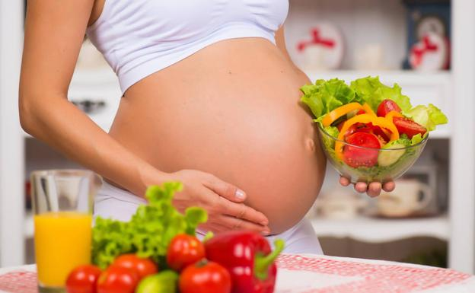
Anemia en Gestantes
I SEMESTRE 2020
2019
2020
Evaluadas | Anemia | % | Evaluadas | Anemia | %
837 | 102 | 12.1 | 1185 | 129 | 10.9
1.2%
Muy Alta Prevalencia ≥ 40%
Alta Prevalencia entre 20 - 39.9%
Mediana Prevalencia entre 5 - 19.9 %
Baja Prevalencia ≤ 4.9%
FUENTE: Sistema de Información del Estado Nutricional – SIEN 2019- 2020.

Slide 11
Anemia Gestantes I SEMESTRE 2020
MICRO RED/ EE.SS | Nro de | ANEMIA LEVE |  | ANEMIA MODERADA |  | ANEMIA SEVERA |  | TOTAL ANEMIAS
 | Evaluado | Nº | % | Nº | % | Nº | % | Nº | %
M.R. LA PAMPA | 78 | 4 | 5.1% | 0 | 0.0% | 0 | 0.0% | 4 | 5.1%
M.R. OCOÑA | 45 | 7 | 15.6% | 1 | 2.2% | 0 | 0.0% | 8 | 17.8%
M.R. SAN GREGORIO | 65 | 5 | 7.7% | 2 | 3.1% | 0 | 0.0% | 7 | 10.8%
M.R. SAN JOSE | 101 | 5 | 5.0% | 1 | 1.0% | 0 | 0.0% | 6 | 5.9%
M.R.IQUIPI | 324 | 23 | 7.1% | 13 | 4.0% | 0 | 0.0% | 36 | 11.1%
M.R. ACARI | 120 | 5 | 4.2% | 1 | 0.8% | 0 | 0.0% | 6 | 5.0%
M.R. CARAVELI | 120 | 7 | 5.8% | 1 | 0.8% | 0 | 0.0% | 8 | 6.7%
M.R. CHALA | 283 | 30 | 10.6% | 20 | 7.1% | 0 | 0.0% | 50 | 17.7%
HOSPITAL CAMANA | 49 | 2 | 4.1% | 2 | 4.1% | 0 | 0.0% | 4 | 8.2%
RED | 1185 | 88 | 7.4% | 41 | 3.5% | 0 | 0.0% | 129 | 10.9%
FUENTE: Sistema de Información del Estado Nutricional – SIEN 2020.

Slide 12
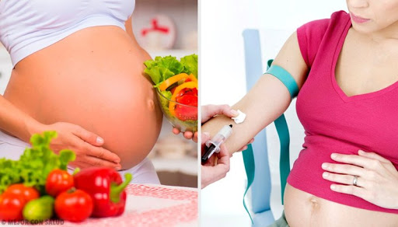
 | ANEMIA
 | Nro de | ANEMIA LEVE |  | ANEMIA MODERADA |  | ANEMIA SEVERA |  | TOTAL ANEMIAS
ESTABLECIMIENTO DE SALUD | Evaluado | Nº | % | Nº | % | Nº | % | Nº | %
Hospital Camaná | 49 | 2 | 4.1% | 2 | 4.1% | 0 | 0.0% | 4 | 8.2%
M.R. LA PAMPA | 78 | 4 | 5.1 | 0 | 0 | 0 | 0 | 4 | 5.1
C.S. LA PAMPA | 20 | 3 | 15.0% | 0 | 0.0% | 0 | 0.0% | 3 | 15.0%
P.S. El Carmen | 27 | 0 | 0.0% | 0 | 0.0% | 0 | 0.0% | 0 | 0.0%
P.S. La Punta | 0 | 0 | 0.0% | 0 | 0.0% | 0 | 0.0% | 0 | 0.0%
P.S. J.P.V. G. | 18 | 0 | 0.0% | 0 | 0.0% | 0 | 0.0% | 0 | 0.0%
P.S. Solidaridad | 5 | 0 | 0.0% | 0 | 0.0% | 0 | 0.0% | 0 | 0.0%
P.S. Quilca | 8 | 1 | 12.5% | 0 | 0.0% | 0 | 0.0% | 1 | 12.5%
M.R. OCOÑA | 45 | 7 | 15.6 | 1 | 2.2 | 0 | 0 | 8 | 17.8
C.S. OCOÑA | 18 | 1 | 5.6% | 0 | 0.0% | 0 | 0.0% | 1 | 5.6%
P.S. La Planchada | 3 | 0 | 0.0% | 0 | 0.0% | 0 | 0.0% | 0 | 0.0%
P.S. Pescadores | 2 | 0 | 0.0% | 0 | 0.0% | 0 | 0.0% | 0 | 0.0%
P.S. La Eugenia | 22 | 6 | 27.3% | 1 | 4.5% | 0 | 0.0% | 7 | 31.8%
M.R. SAN GREGORIO | 65 | 5 | 7.7 | 2 | 3.1 | 0 | 0 | 7 | 10.8
C.S. SAN GREGORIO | 52 | 5 | 9.6% | 2 | 3.8% | 0 | 0.0% | 7 | 13.5%
P.S. Hda. El Medio | 13 | 0 | 0.0% | 0 | 0.0% | 0 | 0.0% | 0 | 0.0%
P.S. Sonay | 0 | 0 | 0.0% | 0 | 0.0% | 0 | 0.0% | 0 | 0.0%
M.R. SAN JOSE | 101 | 5 | 5.0 | 1 | 1.0 | 0 | 0.0 | 6 | 5.9
C.S SAN JOSE | 10 | 1 | 10.0% | 0 | 0.0% | 0 | 0.0% | 1 | 10.0%
P.S. Pucchun | 57 | 1 | 1.8% | 1 | 1.8% | 0 | 0.0% | 2 | 3.5%
P.S. El Cardo | 5 | 0 | 0.0% | 0 | 0.0% | 0 | 0.0% | 0 | 0.0%
P.S. El Puente | 5 | 0 | 0.0% | 0 | 0.0% | 0 | 0.0% | 0 | 0.0%
P.S. F. Cartagena Huacapuy | 24 | 3 | 12.5% | 0 | 0.0% | 0 | 0.0% | 3 | 12.5%
M.R. IQUIPI | 324 | 23 | 7.1 | 13 | 4.0 | 0 | 0 | 36 | 11.1
C.S. IQUIPI | 102 | 4 | 3.9% | 2 | 2.0% | 0 | 0.0% | 6 | 5.9%
P.S. Piuca | 7 | 1 | 14.3% | 1 | 14.3% | 0 | 0.0% | 2 | 28.6%
P.S. Urasqui | 24 | 3 | 12.5% | 2 | 8.3% | 0 | 0.0% | 5 | 20.8%
P.S. Secocha | 191 | 15 | 7.9% | 8 | 4.2% | 0 | 0.0% | 23 | 12.0%
Anemia en Gestantes I SEMESTRE 2020
FUENTE: Sistema de Información del Estado Nutricional – SIEN 2020.

Slide 13
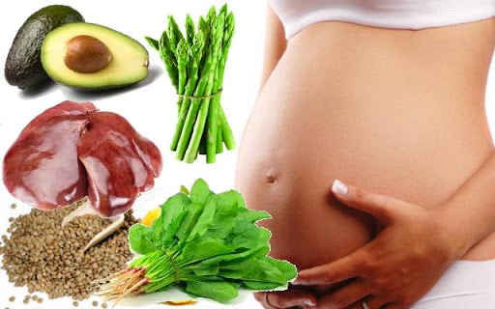
 | ANEMIA
 | Nro de | ANEMIA LEVE |  | ANEMIA MODERADA |  | ANEMIA SEVERA |  | TOTAL ANEMIAS
ESTABLECIMIENTO DE SALUD | Evaluado | Nº | % | Nº | % | Nº | % | Nº | %
M.R. ACARI | 120 | 5 | 4.2 | 1 | 0.8 | 0 | 0 | 6 | 5.0
C.S. ACARI | 53 | 1 | 1.9% | 1 | 1.9% | 0 | 0.0% | 2 | 3.8%
P.S. Bella Unión | 12 | 1 | 8.3% | 0 | 0.0% | 0 | 0.0% | 1 | 8.3%
P.S. Jaqui | 24 | 0 | 0.0% | 0 | 0.0% | 0 | 0.0% | 0 | 0.0%
P.S.Lomas | 15 | 1 | 6.7% | 0 | 0.0% | 0 | 0.0% | 1 | 6.7%
P.S. Yauca | 16 | 2 | 12.5% | 0 | 0.0% | 0 | 0.0% | 2 | 12.5%
M.R. CARAVELI | 120 | 7 | 5.8 | 1 | 0.8 | 0 | 0 | 8 | 6.7
C.S. CARAVELI | 57 | 3 | 5.3% | 0 | 0.0% | 0 | 0.0% | 3 | 5.3%
C.S. Atico | 56 | 4 | 7.1% | 1 | 1.8% | 0 | 0.0% | 5 | 8.9%
P.S. Ayroca | 5 | 0 | 0.0% | 0 | 0.0% | 0 | 0.0% | 0 | 0.0%
P.S. Cahuacho | 2 | 0 | 0.0% | 0 | 0.0% | 0 | 0.0% | 0 | 0.0%
P.S. Sondor | 0 | 0 | 0.0% | 0 | 0.0% | 0 | 0.0% | 0 | 0.0%
M.R CHALA | 283 | 30 | 10.6 | 20 | 7.1 | 0 | 0 | 50 | 17.7
C.S. CHALA | 128 | 6 | 4.7% | 10 | 7.8% | 0 | 0.0% | 16 | 12.5%
P.S. Achanizo | 6 | 2 | 33.3% | 0 | 0.0% | 0 | 0.0% | 2 | 33.3%
P.S. Chaparra | 44 | 6 | 13.6% | 3 | 6.8% | 0 | 0.0% | 9 | 20.5%
P.S. Quicacha | 45 | 12 | 26.7% | 6 | 13.3% | 0 | 0.0% | 18 | 40.0%
P.S. Tocota | 35 | 1 | 2.9% | 0 | 0.0% | 0 | 0.0% | 1 | 2.9%
P.S. Mollehuaca | 17 | 2 | 11.8% | 1 | 5.9% | 0 | 0.0% | 3 | 17.6%
P.S.Atiquipa | 5 | 1 | 20.0% | 0 | 0.0% | 0 | 0.0% | 1 | 20.0%
P.S. Santa Rosa | 3 | 0 | 0.0% | 0 | 0.0% | 0 | 0.0% | 0 | 0.0%
Anemia en Gestantes I SEMESTRE 2020
FUENTE: Sistema de Información del Estado Nutricional – SIEN 2020.

